Slide 1
Rotational motion

Slide 2
Kinematics

Slide 3
Radians
The circumference of a circle is π*diameter, but another way to write this is 2π*radius.
An arc ⅔ of the way around the circle would be ⅔ * 2πr long.
We say that this arc is ⅔ * 2π radians.
An arc that is x radians has an arc length of x*r.
So instead of just saying y degrees out of a total 360 degrees in a circle, we can also say x radians out of a total 2π.

Slide 4
Angular distance
We measure the amount of degrees we’ve turned in terms of radians.
Turning ⅔ of the circle is turning 240 degrees, but it’s also 4π/3 radians.
Why radians? Well if you go ⅔ of the way around an arc of a circle, what’s the distance you’ve walked?
That would be 4π/3 * r where r is the radius of the circle. If we measure this angular distance to be 4π/3, we can easily find the non-angular distance by multiplying radius.

Slide 5
Units
Angular distance is represented as θ, or the greek letter theta.
We actually call the distance we walk around the circle linear distance -- even though it’s not a line -- because it’s not measured as an angle, but in meters, a unit of length that we can measure with a ruler.
Since θ (angular distance) * r (radius) = x (linear distance), and x and r both have units of meters, θ must be unitless.
However, we measured θ in radians, so which is it?

Slide 6
Radians as a unit
If you said you moved an angle of x around a circle, would you know how much you moved around the circle?
Is it x degrees?
Is it x radians?
We wouldn’t know, though the default convention if you don’t include a unit is radians since ° is used to represent degree.
To reduce confusion, we can use the units rad. By definition rad = m/m, which reduces to no units at all since they cancel.

Slide 7
Angular velocity
We can also ask the question of how fast we are changing our angular distance.
The amount of radians we move per second is our angular velocity.
Since this is asking the amount of radians we move per second, the units are rad/s, or sometimes represented as just 1/s.
It’s represented with ω, a lowercase omega, and ωr = v just like how θr = x.

Slide 8
Angular acceleration
Change in angular velocity over time is angular acceleration.
It’s represented as α, has units rad/s², or 1/s², and αr = a.

Slide 9
Direction of angular quantities
We use the right-hand rule where you do a thumbs up, curl your hand in the direction of rotation, and represent the angular quantity in the direction that your thumb points.
The angular quantity is perpendicular to the plane of rotation, and is also perpendicular to all linear vectors of motion at that instant.

Slide 10
Angular kinematics
These kinematic equations are the same as the linear kinematic equations, except angular quantities are involved.
Time, however, does not have an angular component and is preserved between the linear and angular equations.

Slide 11
Rotational second law

Slide 12
Distribution of mass
What’s harder to spin? A tennis ball by itself or a 10 meter long rope with a tennis ball attached to the end?
The further away mass is distributed, the harder it is to spin.
Inertia was how resistant something is to moving linearly, so rotational inertia -- or moment of inertia, represented as “I”, -- is how resistant something is to spinning.
Thus, masses further away have more moment of inertia.

Slide 13
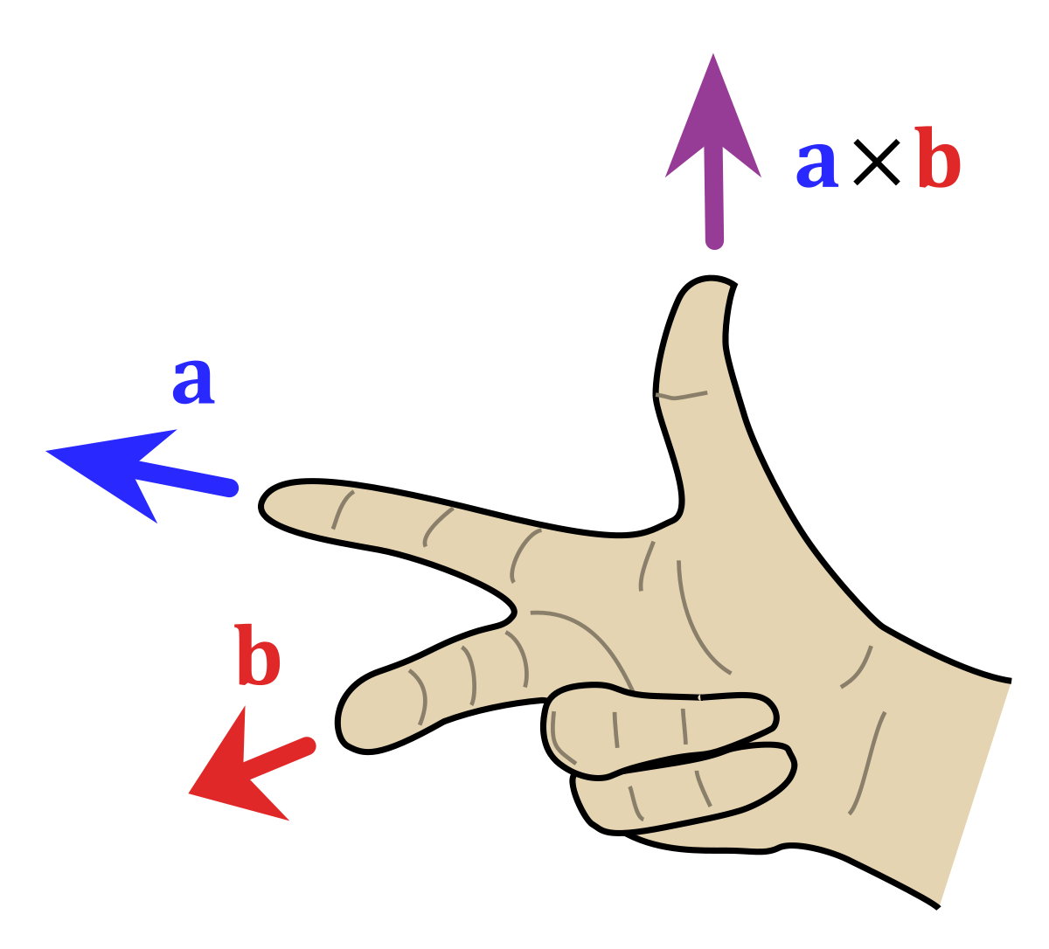
Cross product
There are two ways to multiply vectors: cross products are one of them that return a vector result.
It’s represented as a x b for vectors a, b, and can only be done for 2, 3, and 7 dimensional vectors with the same dimensions.
The cross product has magnitude |a||b|sin(θ) where θ is the angle between the vectors.
The direction of the vector follows the right hand rule shown on right; however, note that a x b = -(b x a).

Slide 14
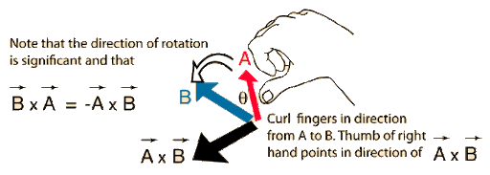
Torque
Torque, symbol “Τ,” represents how forces translate into angular motion and is a cross product between r and F where r is the direction from the pivot to the lever arm and F is the force applied to that pivot.
Note that r x F has magnitude |r||F|sin(θ), which really translates to multiplying the component perpendicular to r of F by the magnitude of r.

Slide 15
Rotational Newton’s second law
We know F = ma as Newton’s second law, but we can change this to capture the idea of rotational kinematics.
We can substitute angular quantities for force, mass, and acceleration for the equation Τ = Iα.
In other words, torque is moment of inertia times angular acceleration.

Slide 16
Moment of inertia for a point mass
We know for a point a distance r away from the pivot, the torque applied by a force F would be Τ = rF, and as the path this point would make would be circular around the pivot, the angular acceleration would be α = a/r.
As F = ma, Τ = rma, and as Τ = Iα, I = Τ/α, which gives I = rma/(a/r) = r²ma/a = r²m.
Thus, for a point of mass m a distance r away, I = mr², which also means I has units of kg * m² as mass is measured in kg and the distance r is measured in m.

Slide 17
Derivations

Slide 18
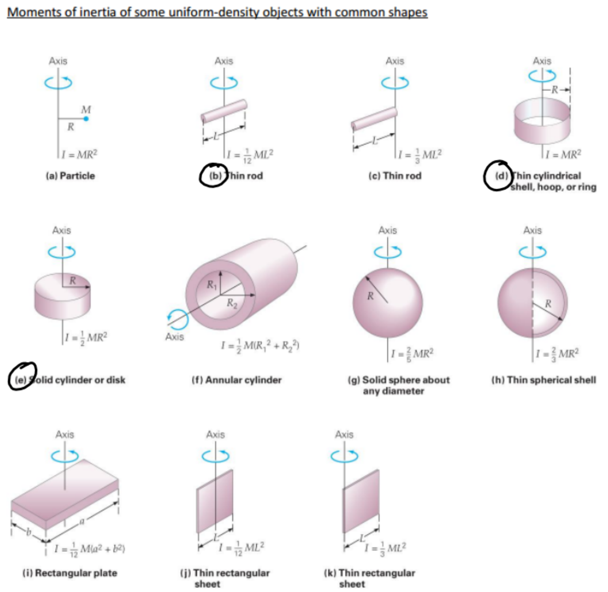
All moments of inertia
There are a few objects it’s good to know moments of inertia for, including the ones on the right.
However, you should also know how the moments of inertia were derived for the three circled diagrams from the I = mr² equation for each point mass.
Image is not from Giancoli, Physics: Principles with Application, but it’s a pretty good introductory physics textbook to read which has a moment of inertia table.

Slide 19
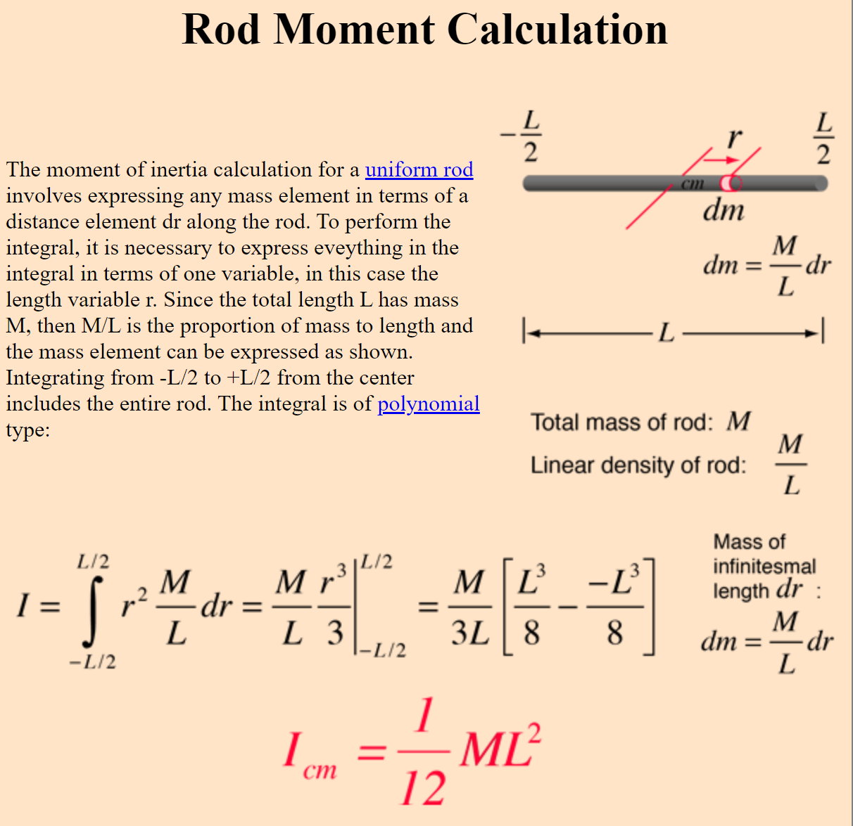
Derivation for a rod
We want to add ρr² where ρ is the mass of each point.
If the total mass of the rod of length L is M, then ρ = M/L as we distribute the mass over the entire length of the rod to find the mass of a point.
Then, we integrate ∫ρr²dr on both sides of the center of mass (thus from L/2 to the left, or -L/2, and L/2 to the right, or +L/2, which gives us I_{cm} = ML²/12.

Slide 20
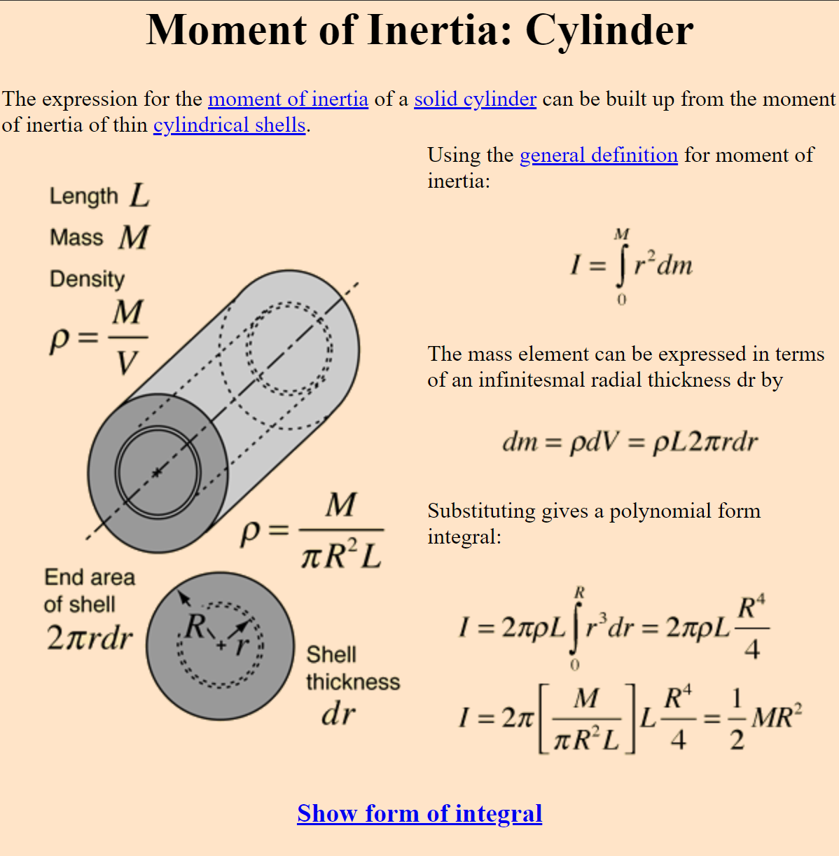
Derivation for a cylinder
We know ρ for each point is M/V as this is a 3d object, so ρ = M/(base*height of cylinder) or ρ = M/(πR²/L).
The volume of a cylindrical shell is (πa²-πb²)h for a height L, inner radius b, and outer radius a. This can be rearranged into πL(a²-b²), or πL(a+b)(a-b).
For a shell of inner radius r and outer radius r+dr for infinitesimally small dr, πL[r+(r+dr)][r-(r+dr)] = πh(2r+dr)(dr) which is close enough to πh(2r)(dr) as dr is infinitesimally small.

Slide 21
Derivation for a cylinder cont.
The moment of inertia from each point on the cylindrical shell will be the same, so the total moment of inertia from all masses on that shell is ∫[ρL(2π)r]r²dr from 0 to R.
Now we substitute in ρ = M/(πR²L) to get the equation I = ∫[M/(πR²L)]L(2π)r³dr, and taking non-r terms out gives I = (2M/R²)∫r³dr.
Integrating from 0 to R, aka adding the moments of inertias of each shell, gives the eventual formula I = MR²/2.

Slide 22
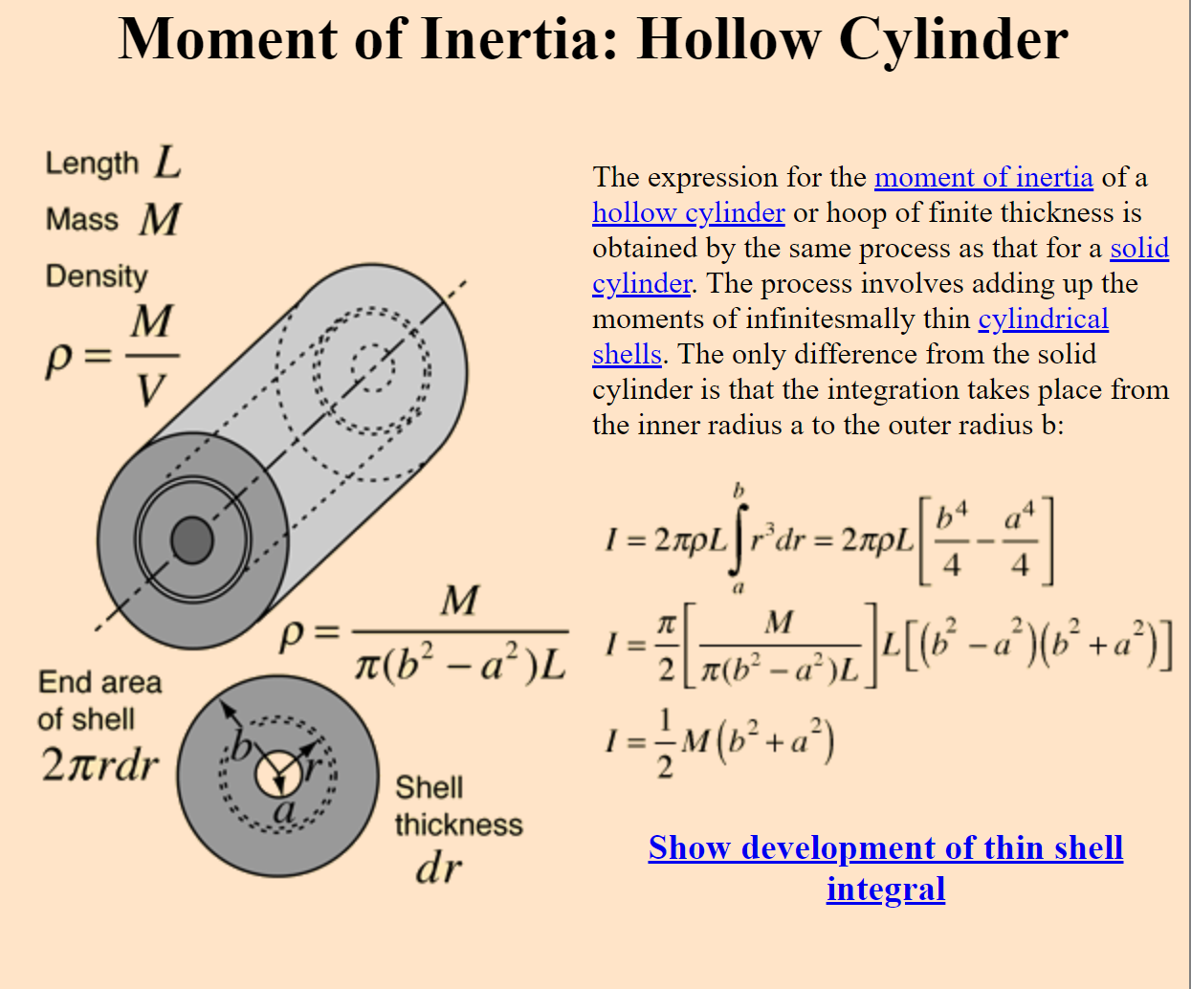
Derivation for a cylindrical shell
Here, we have a cylindrical shell of inner radius a, and outer radius b.
We set up the same integral as the solid cylinder, but instead integrate from a to b instead of from 0 to R to get I = M(a²+b²)/2.

Slide 23
Parallel axis theorem
If we know the moment of inertia about an axis touching the center of mass of an object to be I_{cm}, the moment of inertia a distance d away from the center of mass, which we’ll call I, is given by I = I_{cm} + md², where m is the mass of the object.
This allows us to easily calculate rotational inertia from axes that do not intersect the center of mass if we know I_{cm}.

Slide 24
Angular momentum

Slide 25
Equations
Like how Τ = r x F, angular momentum, represented by L, is given by L = r x p, where p is linear momentum.
However, we also know p = ∫Fdt, so that means L = ∫Τdt.
We also know p = mv, so L = Iω.

Slide 26
Symbols and units
Angular momentum is described with a letter L and angular impulse is represented simply as ΔL.
The units for torque are m*N, so the units of angular momentum are N*m*s, or kg*m²/s.
There are many other ways to derive this as moment of inertia is kg*m², and angular velocity is 1/s, so the product of the two gives angular momentum with units kg * m²/s as well.

Slide 27
Angular momentum with linear motion
If we are watching a race car speed in a straight line from a point not on its path, we will be turning our head to watch it, thus meaning it is rotating and has angular momentum.
If the linear momentum of that race car travelling at a constant velocity is p, then we know L = r x p.
As r x p has magnitude |r||p|sin(θ) where θ is the angle between them, L has that magnitude as well.

Slide 28
Conservation
Angular momentum is also conserved just like linear momentum when no torque is applied.
However, just as if you apply a force, linear momentum can change, the same applies to a system with rotational momentum.
A common example of conservation is a figure skater closing their arms in to reduce their moment of inertia I as mass is closer to the center, thus causing ω to increase to preserve L = Iω, letting them spin faster.

